Slide 1

Transformer
中央研究院 古倫維

Slide 2





關於我
中央研究院資訊科學所-研究員 since 2012
國立陽明交通大學合聘教授
ACL 2024 Program Chair 技術主席
自然語言處理研究 since 1998
@lunweiku 或搜尋 古倫維
古老師研究室

Slide 3
關於中央研究院之 自然語言處理與情感分析實驗室
研究主題：
人工智慧與知識圖譜
假新聞/不實資訊 (干預, 免疫, 高峰預測, 澄清新聞改寫, ...等等)
視覺語言融合技術 (看圖說故事, 機器人視覺認知, 吸眼球視覺問題生成, ...等等)
情感分析 (互動式監督學習推特資料, 謊言偵測, 細微情感分析, ...等等)
可解釋性人工智慧 (假新聞解釋, 推薦原因解釋, 個性化對話)
大型語言模型之調適及前後端應用開發

Slide 4
Outline May. 10: Word Embeddings, From CNN to Transformer, Transformer Framework May. 17: Transformer Encoder Models, Lab 1 May. 24: Transformer Decoder Models, Lab 2 LAB TA: Yili and Luana

Slide 5
Word Features
Why word embeddings?

Slide 6
BOW – Bag of words

Slide 7
Issues
Memory Explosion
The vocabulary of a speaker: 20,000 words
Old bag of words -- Unigram: 20,000, Bigram (first-order): 400 million, Trigram (second-order): 8 trillion
Semantic Computation

Slide 8

Word Embeddings (1)
Word embedding與過去使用的詞向量差異點：
可以做語意運算: king + woman – man = queen

Slide 9
Word embeddings for texts
Word: king
Sentence: I am a king of this small world.
Document:
Biden Warns Putin of Economic Consequences if Aggression Continues
In a tense, two-hour virtual summit, President Biden also warned that an invasion of Ukraine would result in a repositioning of NATO troops in Europe.
But it is too early to tell if the call will ease tensions. President Vladimir Putin gave no indication of his ultimate intent, officials said.

Slide 10
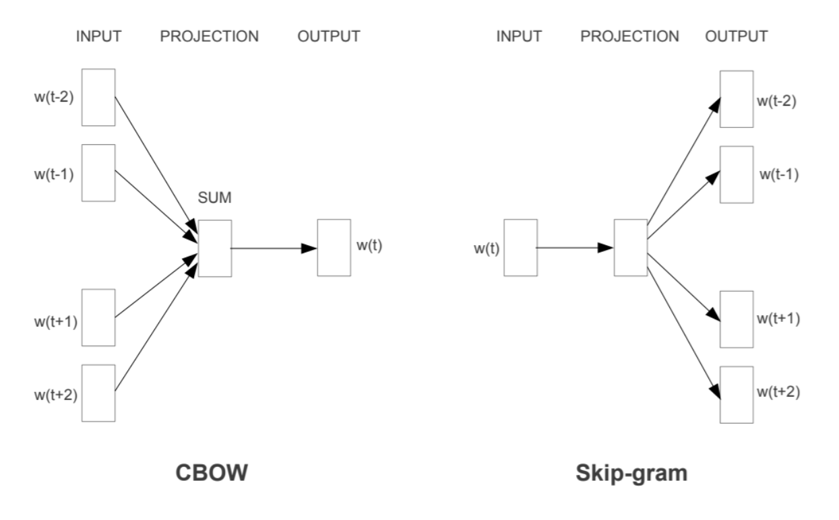
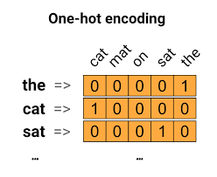
Word Embeddings (2)
Pre-trained or train by yourself!
One-hot vector
w2v (Tomas Mikolov, 2013)
Glove
Fasttext (char level w2v)
Bert Pretrained
You can find various of embeddings on the Web and then use ML models.

Slide 11
WORD EMBEDDINGS(3)
Counting-Based: Glove
Prediction-Based: CBOW, Skip-gram, Bert
Word analogy task: A is to A’ as B is to B’ (spearman’s rank correlation coefficient) is usually used to evaluate word embeddings

Slide 12
CBOW
Sample | Input | Output
1 | [love] | I
2 | [I, natural] | love
3 | [love, language] | natural
4 | [natural, processing] | language
5 | [language] | processing
Skip-gram
Sample | Input | Output
1 | I | [love]
2 | love | [I, natural]
3 | natural | [love, language]
4 | language | [natural, processing]
5 | processing | [language]

Slide 13
From CNN to Transformer

Slide 14
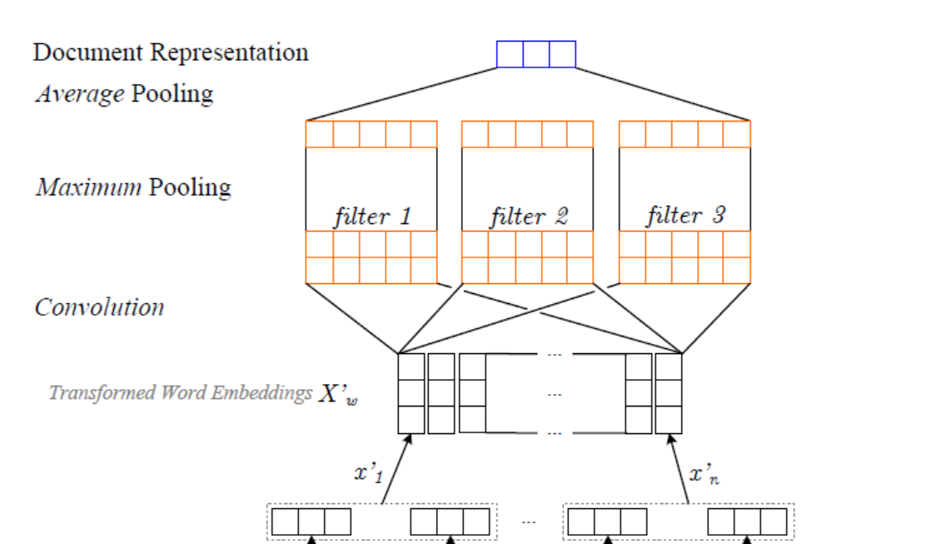
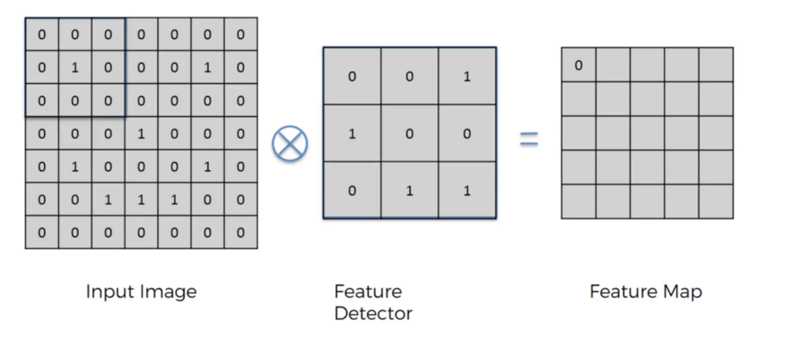
CNN Filter as n-gram

Slide 15
Basic Models
RNN / (Bi)LSTM & NLP: Language is a temporal phenomenon

Slide 16
A simple feedforward NN: ctx len=3

Slide 17
RNN
Recurrent connection in hidden layer: the activation value of the hidden layer depends on current input and the activation value of the hidden layer from the previous time step.

Slide 18
RNN Unrolled

Slide 19
RNN LM
Teacher forcing – Input ground truth at time t-1. (<-> autoregressive)
Teacher forcing is important in transformer.
Exposure bias.
Scheduled sampling to mitigate exposure bias.
Use cross entropy as loss function: measure the difference between predicted probability distribution and the correct distribution

Slide 20
NN Models
Sequence generation
Sequence labeling
Sequence classification

Slide 21
RNN for sequence generation
Starting from <s> as input
Sample the next word
Stop until </s> or the limited length is reached

Slide 22
RNN for sequence labeling

Slide 23
RNN for sequence classification

Slide 24
Stacked RNN

Slide 25
Bi-directional RNN
Hidden layer rather local
Gradient vanishment

Slide 26
Long short-term memory (LSTM)
Removing information no longer needed & adding information likely to be needed for later decision making
Forget gate, add get, output gate

Slide 27
Gated recurrent units
Stop using a separate context vector
Reset gate r, update gate z
Reduce 8 U/W parameters (for 4 gates) to 4 (for 2 gates)

Slide 28
Basic Neural Units
Feedfoward
Simple recurrent network
LSTM
GRU

Slide 29
↑Autoregression
→ Sequential Labeling
↗ Sequence Classification

Slide 30
Transformer: Attention is All You Need
Self-Attention, Multi-head attention, Positional encoding

Slide 31
Self-attention network: Transformer
LSTM: mitigate the loss of distant information due to the recurrence in RNNs
Issue: loss of relevant information and difficulties in training
Transformers: from sequential network back to fully connected network
Innovation: the use of self-attention layers

Slide 32
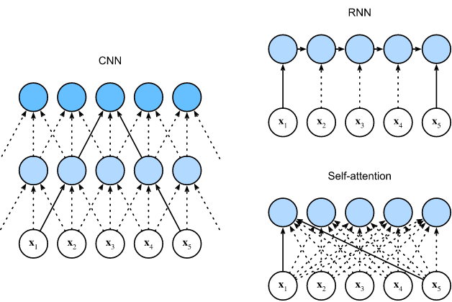
Self-Attention
Figure from gluon.ai

Slide 33
transformer
Information flow
Map x to the same length y

Slide 34
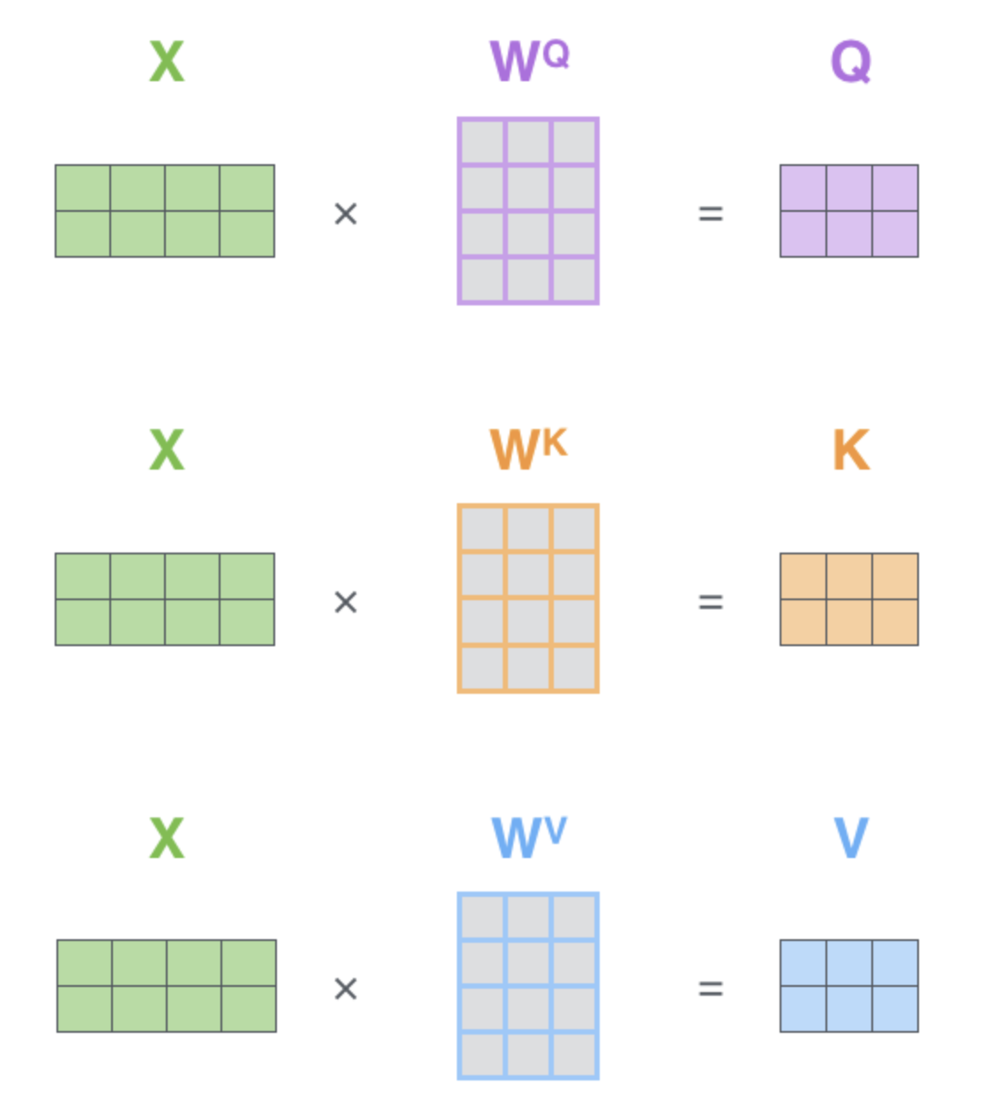
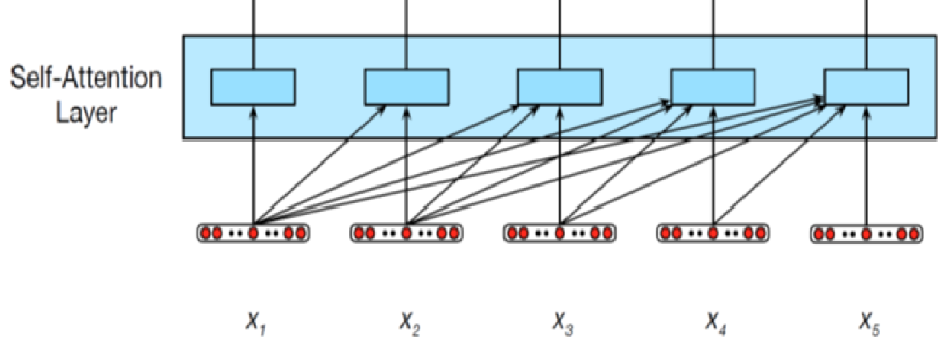
Self attention layer Query, Key, Value in self attention

Slide 36
Transformer
Query, Key, Value (different role of embeddings)
Rewrite formula

Slide 37
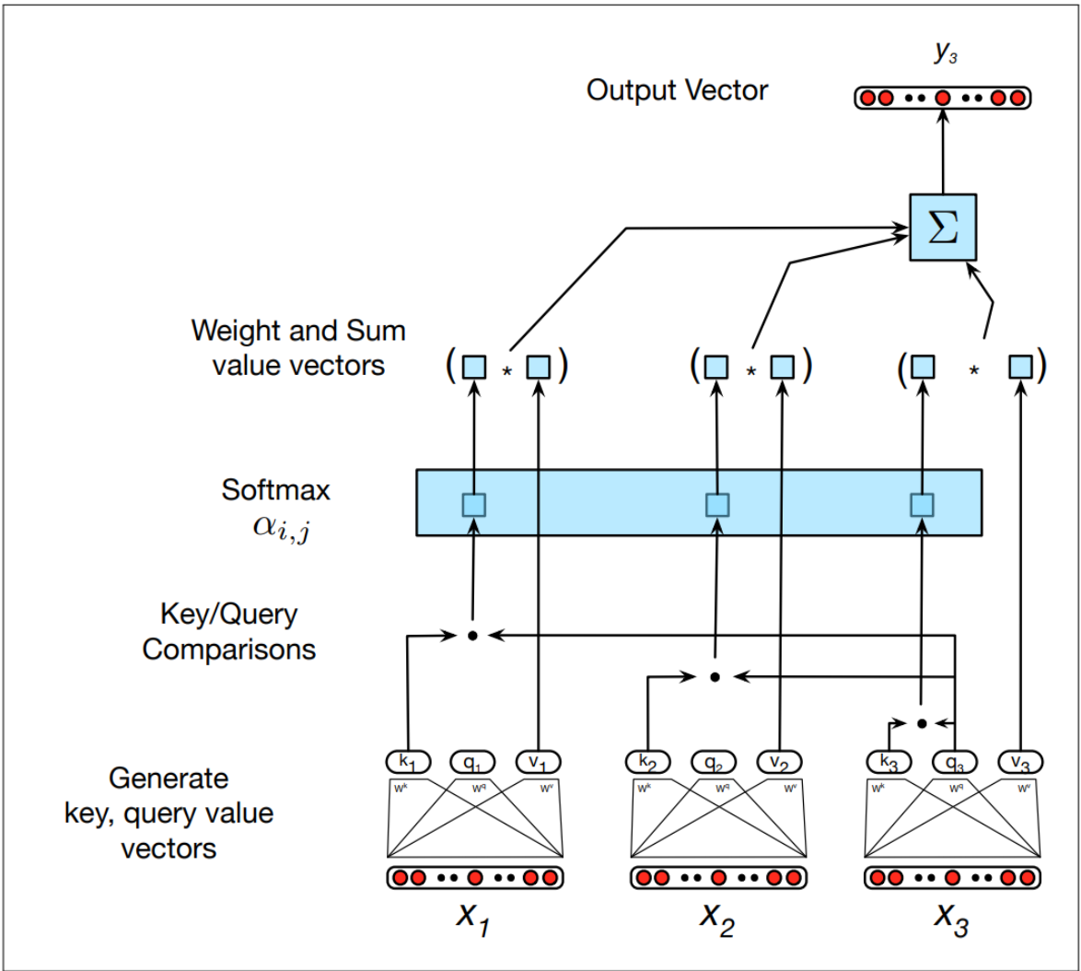
Transformer
Calculate Key, Query, Value
Dot product generates large value for softmax exponential operation ->

Slide 38
Self-attention
Comparisons
Current input to itself and the preceding contexts

Slide 39
Transformer

Slide 40
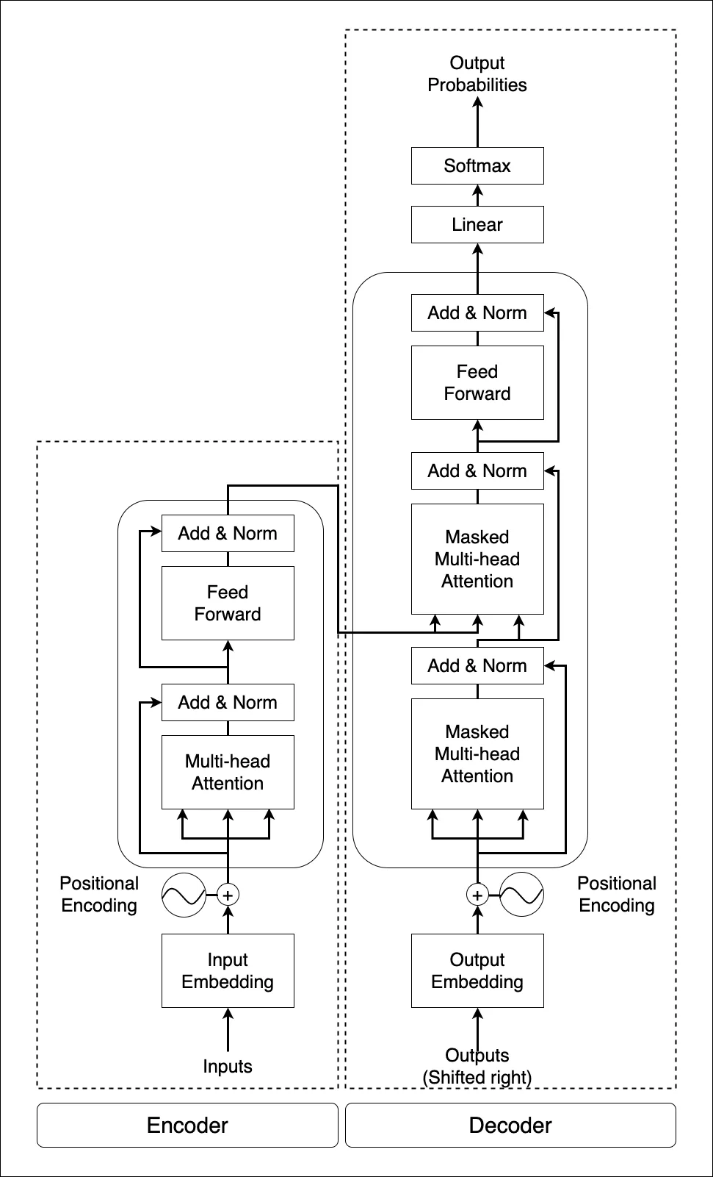
Transformer
Framework

Slide 41
Transformer
Framework
Transformer Block x N, N=3, 6, or more

Slide 42
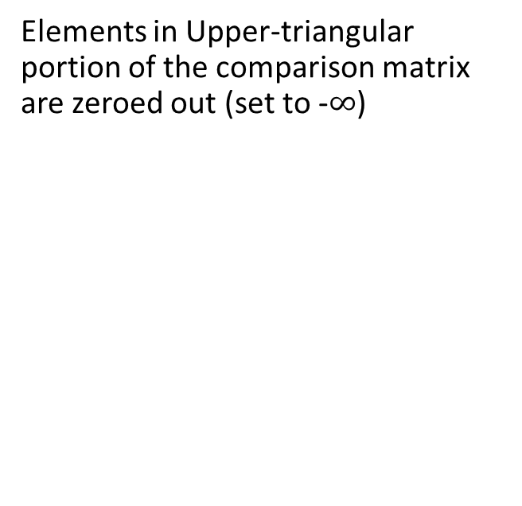
Transformer block
Elements in Upper-triangular portion of the comparison matrix are zeroed out (set to -$∞$)

Slide 43
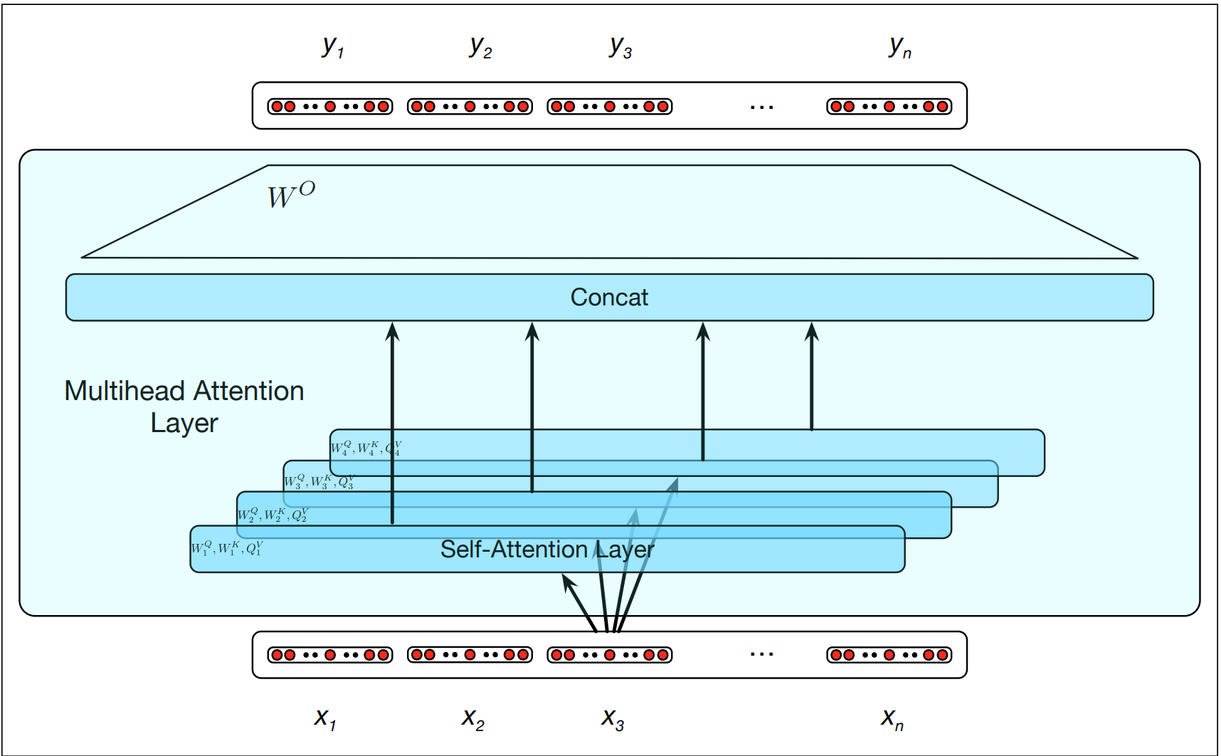
Multi-head self-attention
Different words relate to each other in many different ways, e.g., syntactic, semantic, discourse relations…

Slide 44
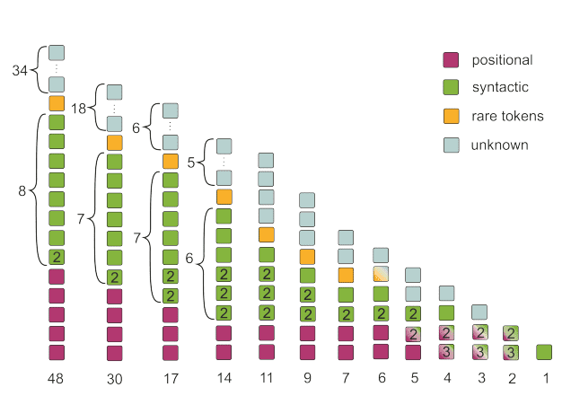
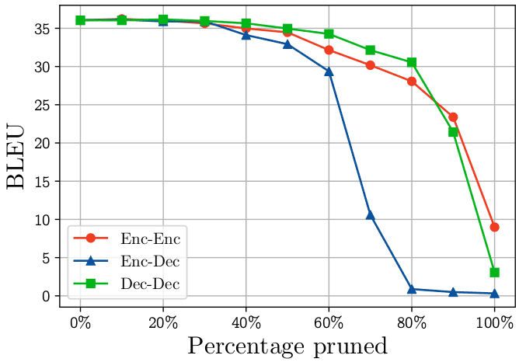
Multi-head? How many?
Voita et al., “Analyzing Multi-Head Self-Attention: Specialized Heads Do the Heavy Lifting, the Rest Can Be Pruned”.
Positional heads
Syntactic heads
Heads pointing to rare words

Slide 45
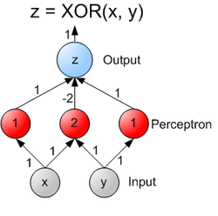
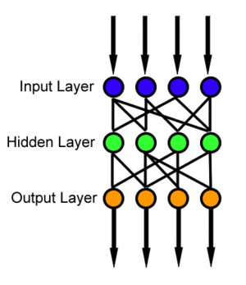
Feed Forward Network
From dimension d to 4d and back to d by ReLu
Project to higher dimension and back to the original dimension
Better distill important information

Slide 46
Feed Forward Network
Transformer Feed-Forward Layers Are Key-Value Memories (Mor et al., 2021)

Slide 47
Transformer
Framework

Slide 48
Transformer
Encoder

Slide 49
Transformer
Decoder

Slide 50
Transformer

Slide 51
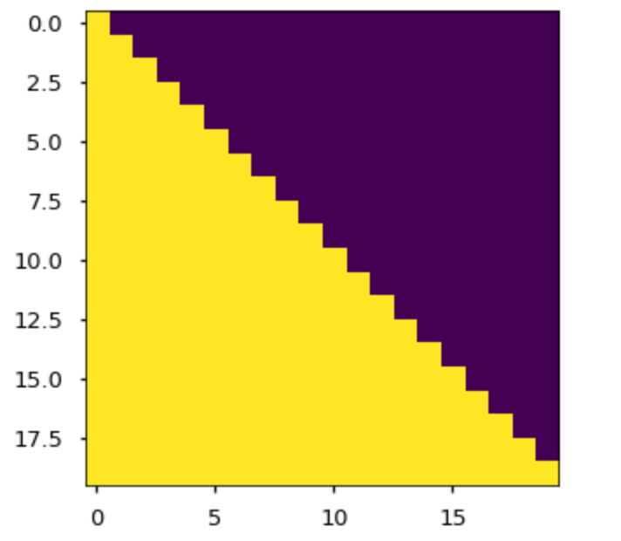
Masked

Slide 52
↑Autoregression
→ Sequential Labeling
↗ Sequence Classification

Slide 53
transformer
Autoregressive text completion

Slide 54
Positional Encoding & Positional Embedding

Slide 55
Positional Encoding: Keep Position Information
Use 1, 2, …, N?
Three requirements (for generalizability):
Different position has different encoding.
Intervals should be consistent
Can be applied to sentences of any length

Slide 56
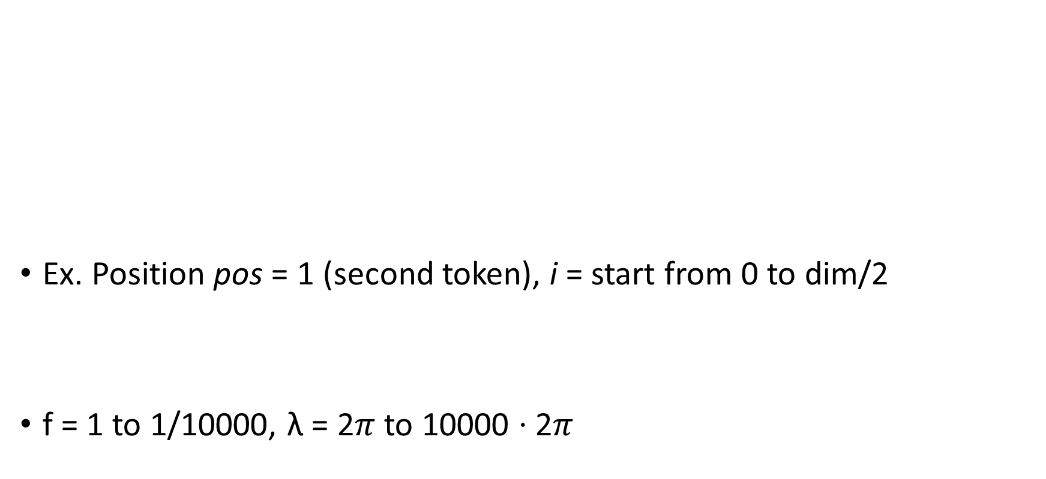
Positional encoding
Ex. Position pos = 1 (second token), i = start from 0 to dim/2
f = 1 to 1/10000, λ = 2$π$to 10000 ‧ 2$π$

Slide 57
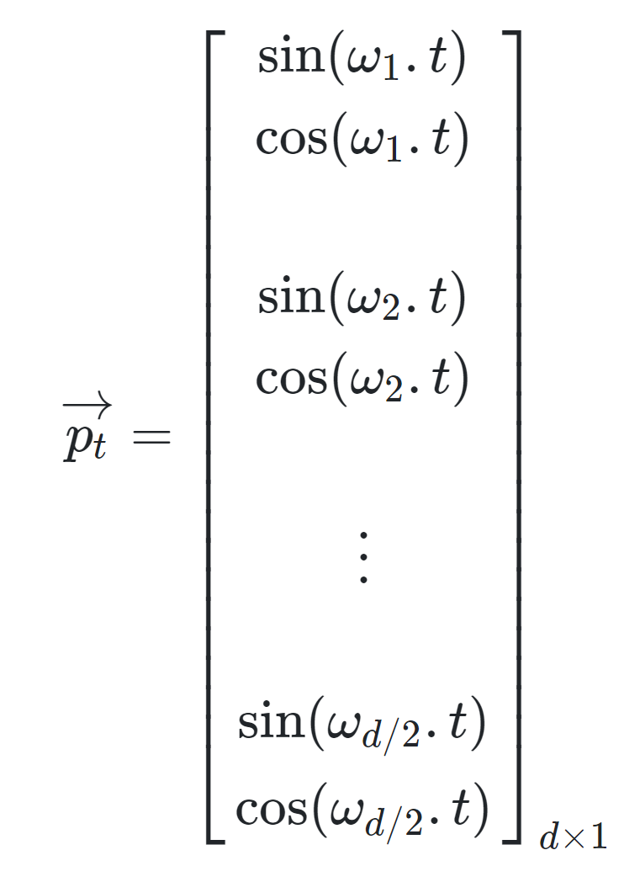
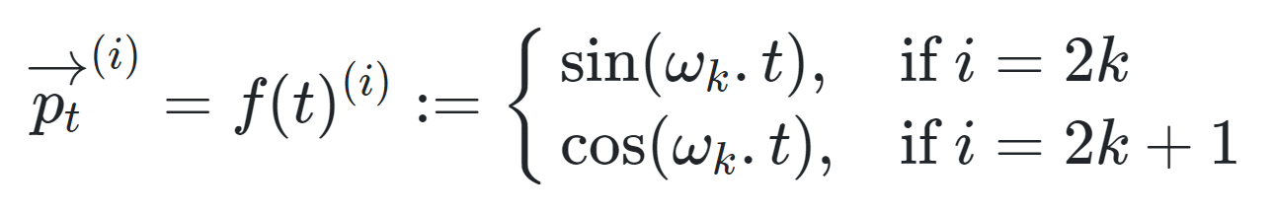
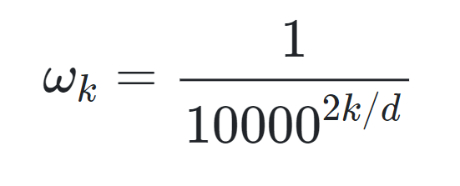
Positional encoding

Slide 58
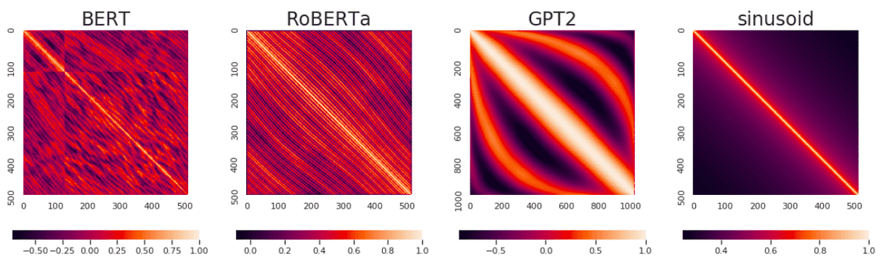
Positional Embeddings
Different from positional encoding
Each position is mapped to a trainable vector of size dim
Positional embeddings are trainable, positional encodings are fixed.
Wang and Chen (2020) What Do Position Embeddings Learn? An Empirical Study of Pre-Trained Language Model Positional Encoding.

Slide 59
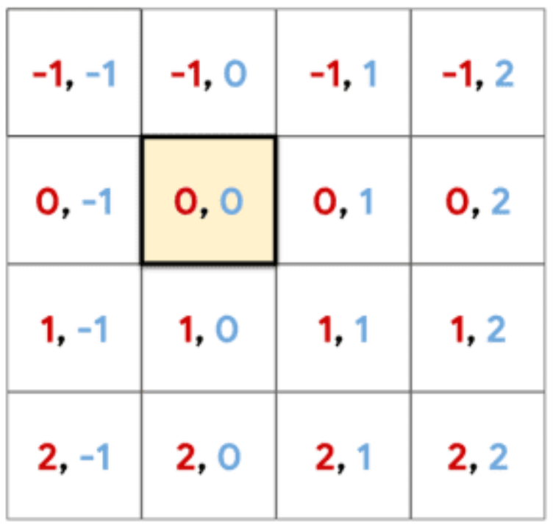
Positional Embedding
Absolute position
Relative position

Slide 60
Transformer Training/Testing Phase

Slide 61
Transformer Training/Inference Input/Output
Transformer training phase: parallel
Use the technique of teacher forcing
Transformer testing phase: decoder not parallel
Generate output by looking at the input from the previous timestamp

Slide 62
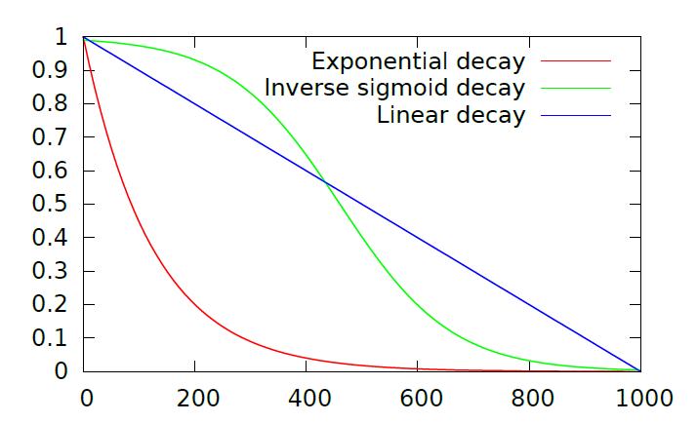
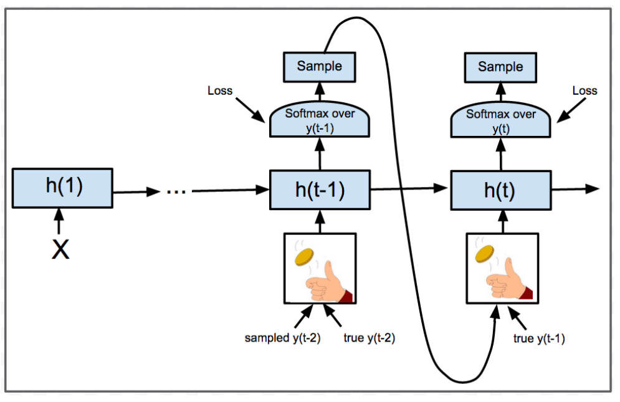
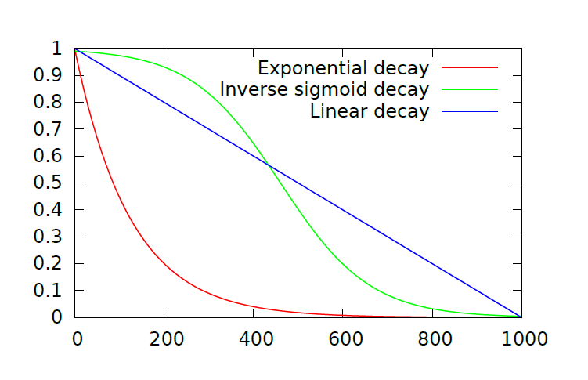
Teacher Forcing
Exposure Bias
Diversity
Overcorrect
Scheduled Sampling

Slide 63
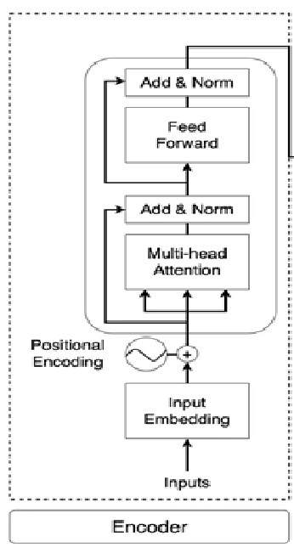
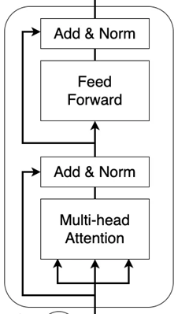


Encoder
Decoder
Stack N = 6 (layers)

Slide 64
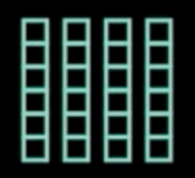
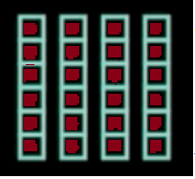
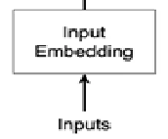
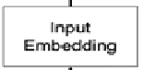
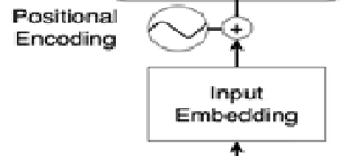
Input
m_d = 512
I am learning Transformer

Slide 65
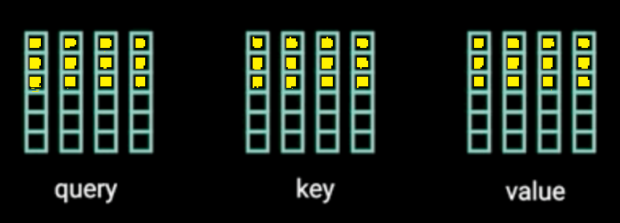
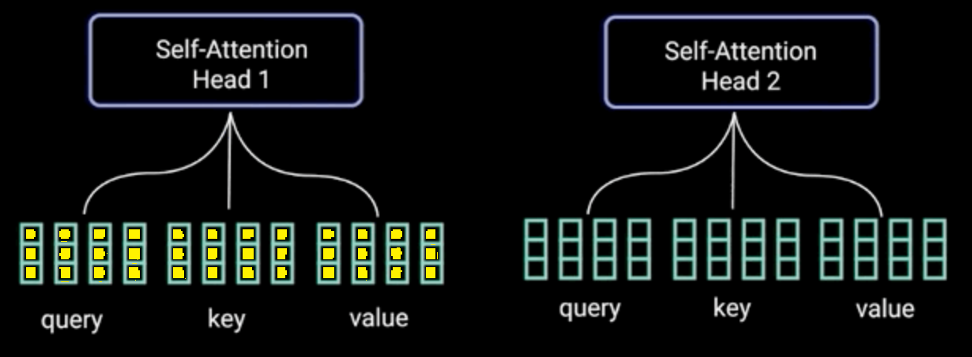
Multi-head h=2 as an example (h=8, h_d=512/8=64)

Slide 66
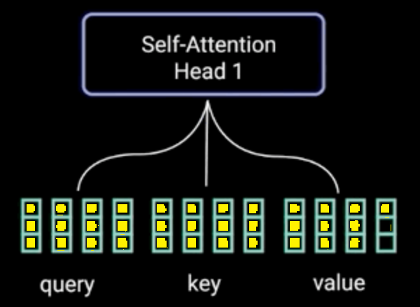
x1 x2 x3 …
x1 x2 x3 …
x1 x2 x3 …

Slide 67
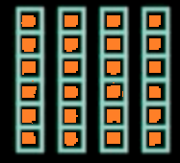
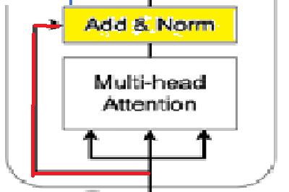
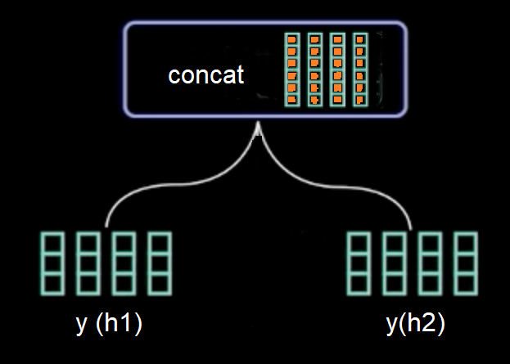
Residual Connection, LayerNorm( + )

Slide 68
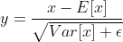
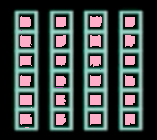
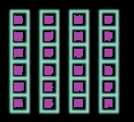
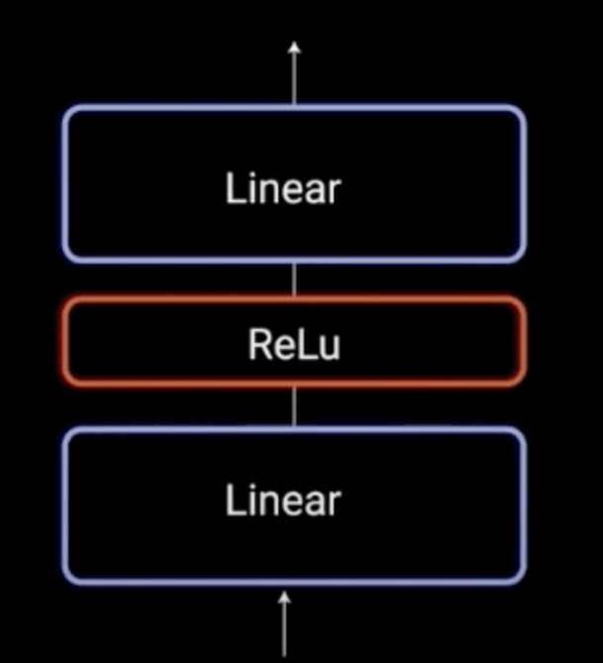
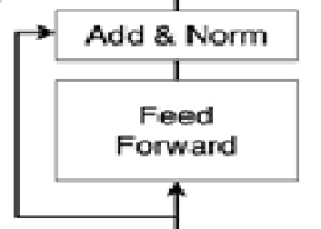
= LayerNorm( + )
make
mean=0, var =1
Input To Decoder for Cross Attention
d_model =512
d_ff =2048

Slide 69
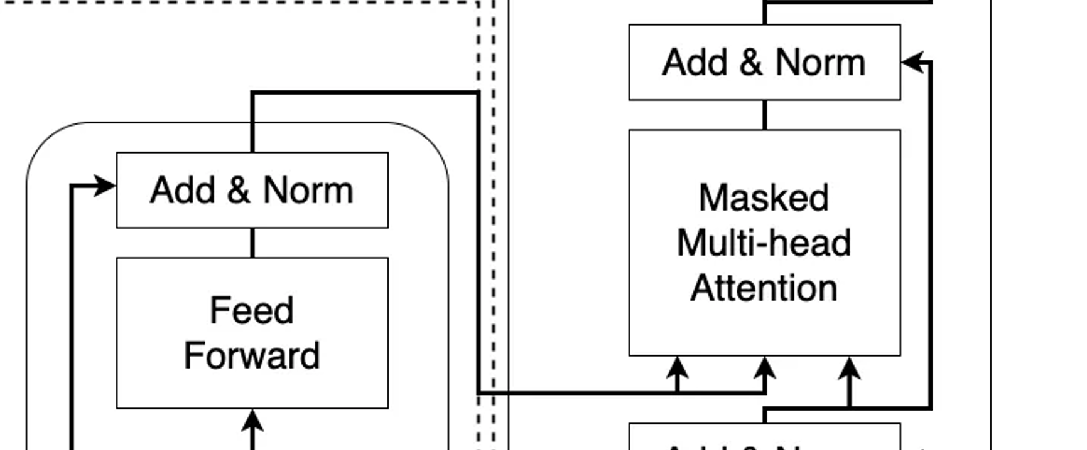
Encoder Decoder

Slide 70
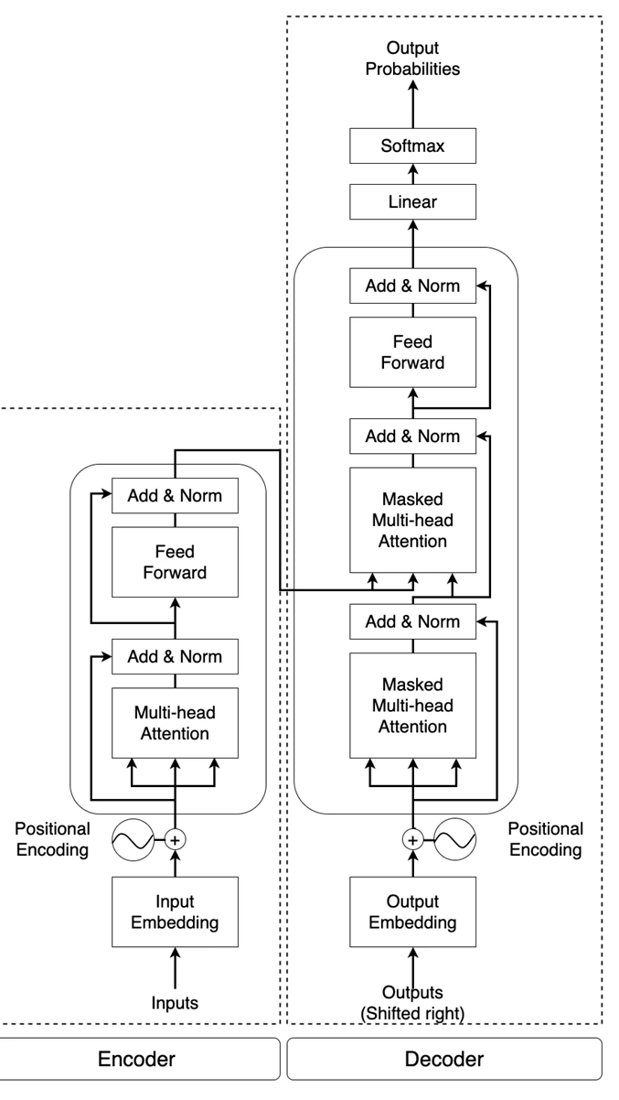
Dropout

Slide 72
Label Smoothing
Happy = [1, 0, 0]
Sad =[0, 1, 0]
Angry=[0, 0, 1]
Ls=0.1:
Happy = [0.9, 0.05, 0.05]
Sad =[0.05, 0.9, 0.05]
Angry=[0.05, 0.05, 0.9]

Slide 73
Transformer Training

Slide 74
Dataset
English-German: standard WMT 2014 English-German dataset consisting of about 4.5 million sentence pairs, Vocabulary~37000 tokens
English-French: the significantly larger WMT 2014 English-French dataset consisting of 36M sentences and split tokens into a 32000 word-piece vocabulary
One machine with 8 NVIDIA P100 GPUS
Base model 12 hours, Big model 3.5 days

Slide 75
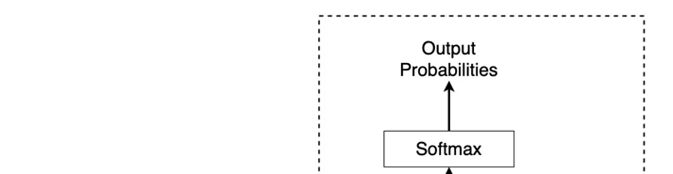
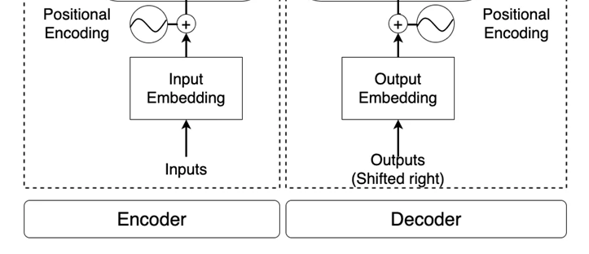
t=0 t=1
Is it interesting ? … <eos>
K, V
……
I am learning Transformer <s> Is it interesting ?

Slide 76
Is it interesting ? … <eos>
……
I am learning Transformer <s> Is it interesting ?

Slide 77
difficult
Is it ? … <eos>
……
I am learning Transformer <s> Is it interesting ?

Slide 78
Transformer Inference

Slide 79
t=0 t=1~n
Is it interesting ? … <eos>
Is he a student … <eos>
K, V
……
I am learning Transformer <s> Is he a

Slide 80
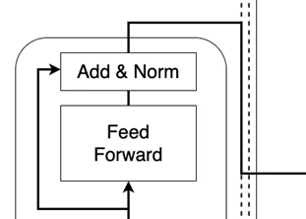
Is he a student … <eos>
……
I am learning Transformer <s> Is he a

Slide 81
Masking in Decoder
Query Mask
K, Q, Future Mask
Future Mask
Key Mask

Slide 82
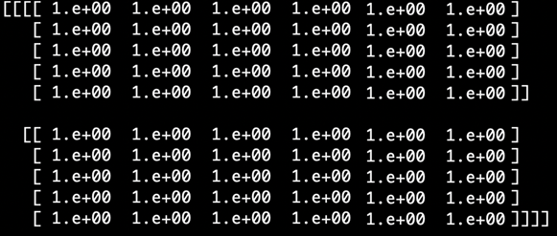
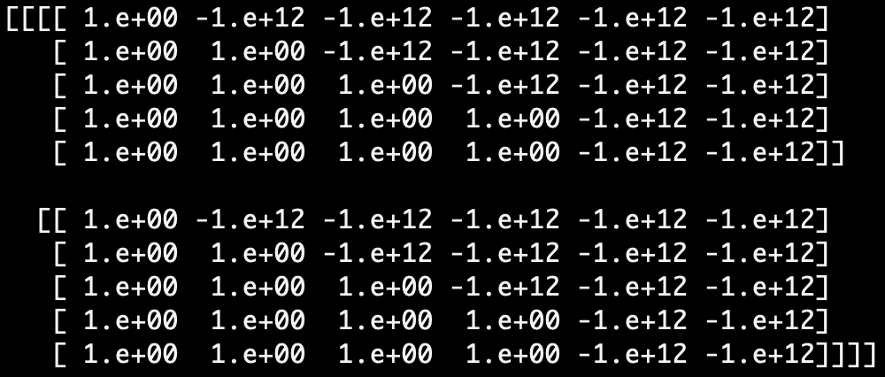



Slide 83
Masking in Encoder?
Yes, but for different purpose
Masked attention on padding
Example: vector = [2, 0.5, 0.8, 1, 0, 0, 0, 0] (padded), softmax = [0.41, 0.09, 0.12, 0.15, 0.06, 0.06, 0.06, 0.06]
Masking before softmax: set padded values to -inf masking = [2, 0.5, 0.8, 1, -1e9, -1e9, -1e9, -1e9] softmax = [0.53, 0.12, 0.16, 0.19, 0, 0, 0, 0]
Please refer to LAB codes

Slide 84
Transformer for Tasks

Slide 85

Transformer for Translation

Slide 86
Transformer for English Parsing

Slide 87
transformer
Summarization
This scheme can be used in text-to-text applications, e.g., MT, QA

Slide 88
Embeddings for Codes
A Cross-Architecture Instruction Embedding Model for Natural Language Processing-Inspired Binary Code Analysis
Kimberly Redmond, Lannan (Lisa) Luo, Qiang Zeng
University of South Carolina

Slide 89
Transformer Inference
EFFICIENT TRANSFORMER FOR MOBILE APPLICATIONS,
https://zhanghaowu.me/assets/pdf/Presentation_ENMT.pdf

Slide 90

Improving Inference Speeds of Transformer Models, https://medium.com/gumgum-tech/improving-inference-speeds-of-transformer-models-e03944a018aa

Slide 91
Pre-trained Image Processing Transformer, CVPR 2021

Slide 92
More Transformer Applications
Spatial-Temporal Transformer for Dynamic Scene Graph Generation (ICCV 2021)

Slide 93
Visual Story Telling: KG-VIST, PR-VIST

